Slide 1
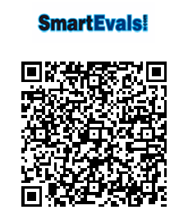
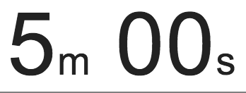

Slide 2
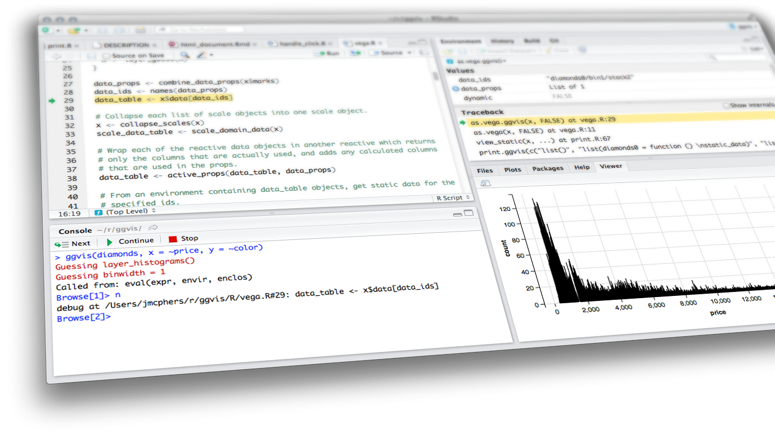

bookmarking
Shiny from

Slide 3
Bookmarking
How to bookmark
Bookmarking options
Customizing bookmarks

Slide 4
Motivation

Slide 5
motivation
Capture the results you're currently seeing in a Shiny app, by snapshotting inputs and state
Creates a URL that can be shared with others, or bookmarked for your own future use
Applications:
Collaboration across researchers: Biostatistician creates an app, passes on to the biologist to explore, biologist wants to communicate specific findings back to the biostatistician
Sharing results with a coworker/manager: Instead of sending someone to your app and then asking them to click this, check that, choose this, etc.
Education:
If using a Shiny app to teach concepts, students might be asked to play around with a distribution by tweaking inputs, and submit the output
Or an instructor might want to provide multiple scenarios in an app for students to explore

Slide 6
How to
bookmark

Slide 7
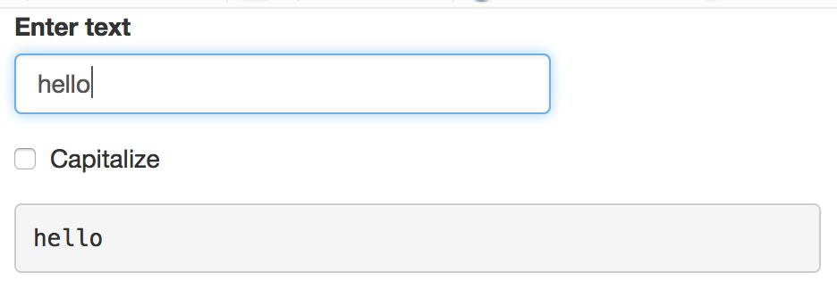
A very simple app
ui <- fluidPage(
textInput("txt", "Enter text"),
checkboxInput("caps", "Capitalize"),
verbatimTextOutput("out")
)
server <- function(input, output, session) {
output$out <- renderText({
ifelse(input$caps, toupper(input$txt), input$txt)
})
}
shinyApp(ui, server)

Slide 8
Enabling bookmarking
UI portion must be a function that takes one argument
ui <- function(request) {
fluidPage(
textInput("txt", "Enter text"),
checkboxInput("caps", "Capitalize"),
verbatimTextOutput("out"),
bookmarkButton()
)
}
server <- function(input, output, session) {
output$out <- renderText({
ifelse(input$caps, toupper(input$txt), input$txt)
})
}
shinyApp(ui, server, enableBookmarking = "url")
A button for bookmarking
There must be a call to enableBookmarking()

Slide 9
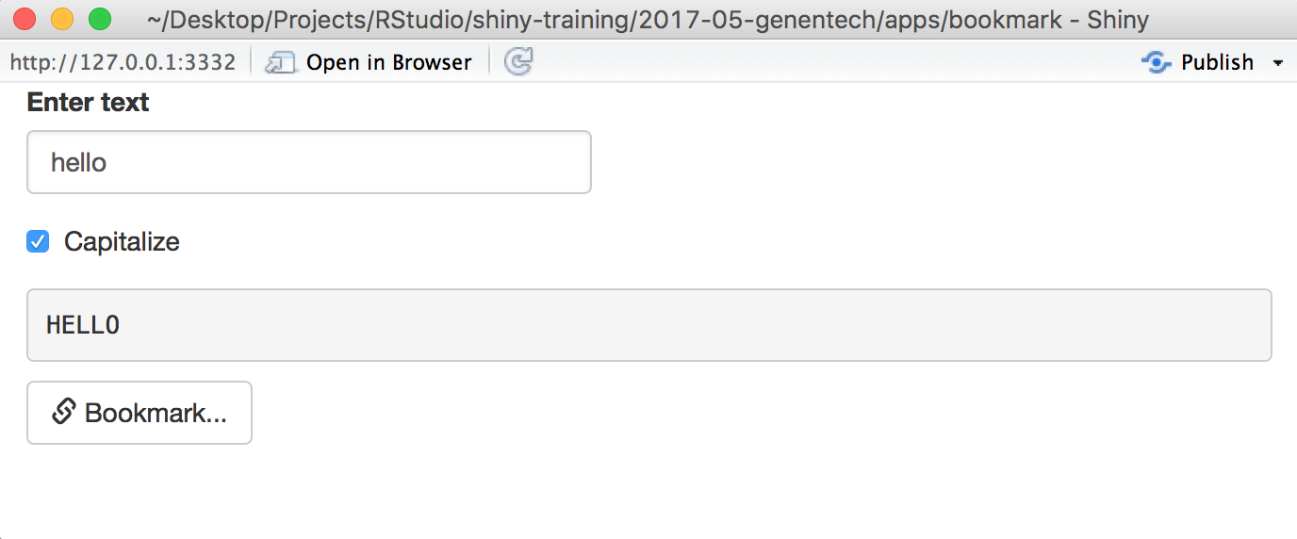
demo
bookmark_01.R
Shiny from
© 2016 RStudio, Inc. All rights reserved.

Slide 10
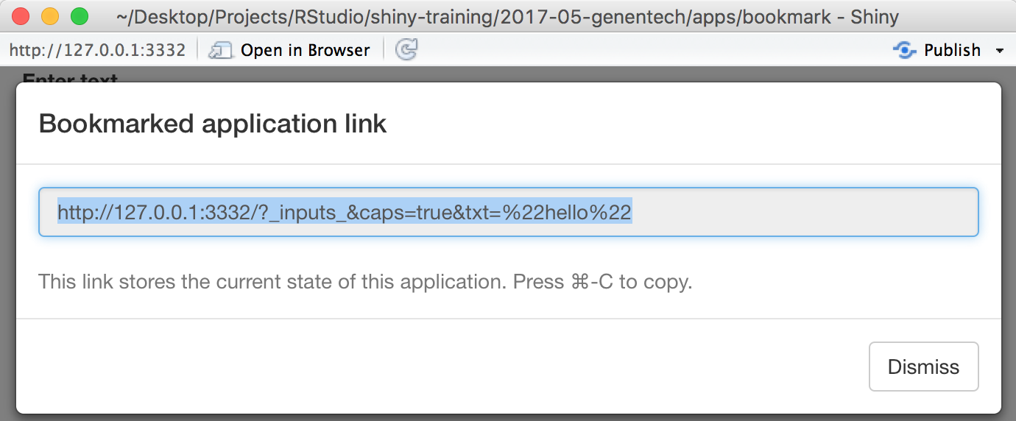
demo
bookmark_01.R
Shiny from
© 2016 RStudio, Inc. All rights reserved.

Slide 11
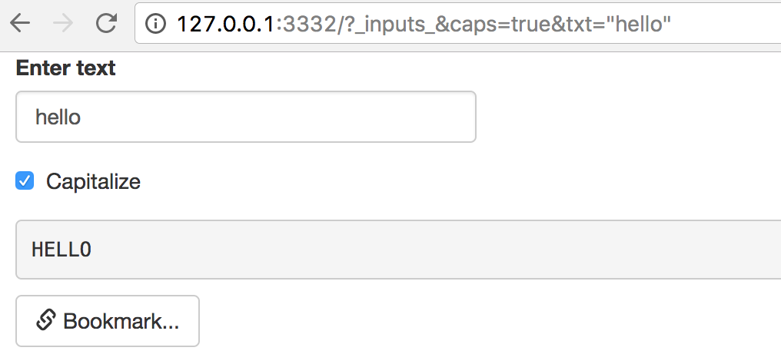
demo
bookmark_01.R
Shiny from
© 2016 RStudio, Inc. All rights reserved.

Slide 12
how bookmarking works
Bookmarked state automatically saves the input values (except passwords) such that when the application is restored using that state, the inputs are seeded with the saved values
File inputs are saved only when state is saved to server (not with URL encoding)

Slide 13
Bookmarking
options

Slide 14
types of bookmarking
URL-encoded | Saved-to-server
No state on server | State saved on server
URLs may be long & values revealed in URL | Always a short URL
URL length limits data (~2K characters on some browsers) | No limits on data
Can’t store uploaded files | Can store uploaded files
Best for simple apps without too much state to serialize | Appropriate for large amounts of state, incl files and directories if necessary

Slide 15
Enabling bookmarking
ui <- function(request) {
fluidPage(
textInput("txt", "Enter text"),
checkboxInput("caps", "Capitalize"),
verbatimTextOutput("out"),
bookmarkButton()
)
}
server <- function(input, output, session) {
output$out <- renderText({
ifelse(input$caps, toupper(input$txt), input$txt)
})
}
shinyApp(ui, server, enableBookmarking = "server")
Only change for saving to server

Slide 16
DEPLOYED EXAMPLES
URL-encoded | Saved-to-server
https://gallery.shinyapps.io/113-bookmarking-url/ | https://gallery.shinyapps.io/bookmark-saved/?_state_id_=d80625dc681e913a
https://gallery.shinyapps.io/113-bookmarking-url/?_inputs_&n=200

Slide 17
Customizing
bookmarks

Slide 18
excluding inputs
Inputs that should not be bookmarked can be excluded with setBookmarkExclude() in the server function, which takes in a vector containing the names of the inputs
server <- function(input, output, session) {
setBookmarkExclude(c("x", "y"))
}

Slide 19
multiple tabs
It is possible to bookmark which tab in a tabset is active
This requires providing IDs for tabsetPanel(), navbarPage(), or navlistPanel()
If you have multiple tabs, you likely want the bookmark button to show up on each tab
This also requires providing IDs for bookmarkButton(), and also excluding the bookmarking of the bookmark buttons themselves

Slide 20
demo
bookmark_02.R
Two tabs with checkboxes,
and bookmark button on each tab
server <- function(input, output, session) {
# Need to exclude the buttons from themselves being bookmarked
setBookmarkExclude(c("bookmark1", "bookmark2"))
# Trigger bookmarking with either button
observeEvent(input$bookmark1, {
session$doBookmark()
})
observeEvent(input$bookmark2, {
session$doBookmark()
})
}
To trigger bookmarking from each button, use observeEvent() for each button that calls session$doBookmark().
Shiny from
© 2016 RStudio, Inc. All rights reserved.

Slide 21
input dependence
Fully input-dependent apps: The state of the outputs at time t is fully determined by the state of the inputs at time t
Bookmarking should “just work”
Partly input-dependent apps: The state of the outputs at time t is only partly determined by the state of the inputs at time t — other things may influence it, including inputs at previous times, or external data
These apps are not fully reactive
Bookmarking requires additional tools to save & restore desired state

Slide 22
demo
bookmark_03.R
Displays the sum of all previous slider values added
ui <- fluidPage(
sidebarPanel(
sliderInput("n", "Value to add", min = 0, max = 100, value = 50),
actionButton("add", "Add"),
),
mainPanel(
h4("Sum:", textOutput("sum"))
)
)
server <- function(input, output, session) {
vals <- reactiveValues(sum = 0)
observeEvent(input$add, {
vals$sum <- vals$sum + input$n
})
output$sum <- renderText({
vals$sum
})
}
shinyApp(ui, server, enableBookmarking = "url")
State of output not fully determined by state of inputs since previous input values matter as well
Each time “Add” button is clicked, add input$n to vals$sum, then render text of the sum value
Shiny from
© 2016 RStudio, Inc. All rights reserved.

Slide 23
demo
ui <- function(request) {
fluidPage(
sidebarPanel(
sliderInput("n", "Value to add", min = 0, max = 100, value = 50),
actionButton("add", "Add"),
),
mainPanel(
h4("Sum:", textOutput("sum"))
)
bookmarkButton()
)
}
server <- function(input, output, session) {
vals <- reactiveValues(sum = 0)
onBookmark(function(state) {
state$values$currentSum <- vals$sum
})
onRestore(function(state) {
vals$sum <- state$values$currentSum
})
observeEvent(input$add, {
vals$sum <- vals$sum + input$n
})
output$sum <- renderText({
vals$sum
})
}
shinyApp(ui, server, enableBookmarking = "url")
bookmark_04.R
When app is bookmarked,
save vals$sum in the
bookmark state values
When app is restored,
retrieve vals$sum from the bookmark state values
Shiny from
© 2016 RStudio, Inc. All rights reserved.

Slide 24

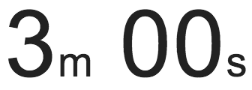
exercise
Run bookmark_04.R
There is a bug, what is it?
Can you fix it?
Shiny from
© 2016 RStudio, Inc. All rights reserved.

Slide 25
Solution
Solution to the previous exercise
bookmark_05.R
Shiny from
© 2016 RStudio, Inc. All rights reserved.

Slide 26
bookmarking
Shiny from

Slide 27
Final Project Office hrs
Shiny from

